Slide 1
Hidden Terminal Problem and Exposed Terminal Problem in Wireless MAC Protocols

Slide 2
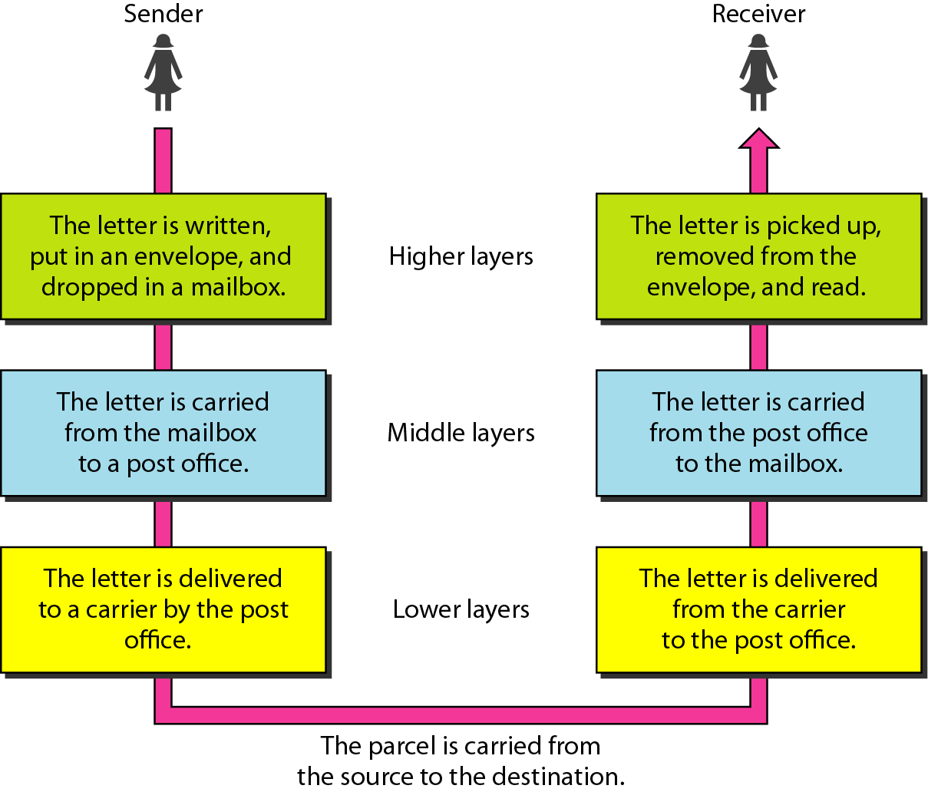

Slide 3
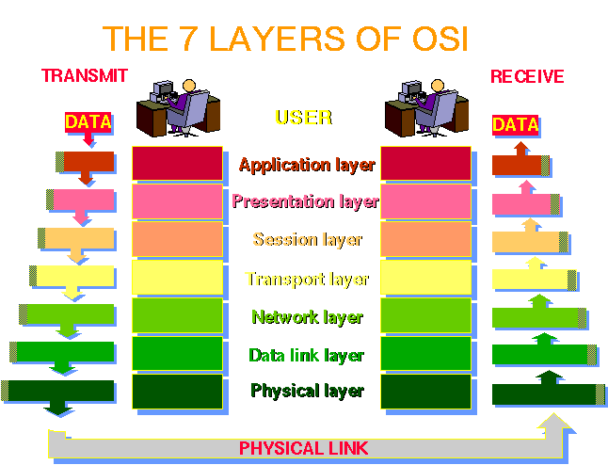

Networking basics
Medium Access
Control (MAC)
Protocol
Notes:
The Open Systems Interconnection (OSI) model is a product of the Open Systems Interconnection effort at the International Organization for Standardization (ISO).

Slide 4
Characteristics of Wireless Networks
Multiplexing: in a mobile and wireless network, the wireless medium is shared by many nodes.
Hence, multiple use of a shared medium is a major challenge in wireless networking.
Most decisions for accessing the wireless medium is made in the MAC layer.

Slide 5
Multiplexing
The wireless channels can be multiplexed in four dimensions:
Time(t): A channel gets the whole frequency spectrum for a certain amount of time.
Space(s): Same frequency can be reused when the base stations are separated in space.
Frequency(f): The whole spectrum is separated into smaller frequency bands.
Code(c):Each channel uses a unique code for transmitting.

Slide 6
Time Division Multiplex (TDM)
A channel gets the whole frequency spectrum for a certain amount of time.
Only one user for the medium at a time.
Usually the throughput is high even with many users.
However, no two users should use the medium at the same time. Precise synchronization is needed.
f
t

Slide 7
Space multiplexing : Cellular Networks
Same frequency can be reused when the base stations are separated in space.
The reuse of frequencies depend on signal propagation range.
Example : fixed frequency assignment for reuse with distance 2.

Slide 8
Frequency Division Multiplex (FDM)
The whole spectrum is separated into smaller frequency bands.
A band is allocated to a channel for the whole time.
This is somewhat inflexible if the traffic is non-uniform.
An example is radio or TV broadcast. The bandwidth is wasted if a station is off the air.
f
t

Slide 9
Code Division Multiplex (CDM)
Each channel uses a unique code for transmitting.
All channels use the same frequency spectrum at the same time.
However, signal regeneration is very complex and requires complex HW/SW support.
c
t
f

Slide 10
Code Division Multiplexing
CDMA has ben adopted for the 3G mobile phone technology.
CDMA is not very suitable for ad hoc networking as we cannot expect specialized hardware/software support at the nodes.
TDMA and its variations are most suitable for ad hoc networking.

Slide 11
An example of Time Division Multiplexing
CSMA/CD: Carrier Sense Multiple Access with Collision Detection
When a node wants to broadcast, it checks whether any other node is broadcasting (senses the carrier).
A node broadcasts when no other node is broadcasting. Otherwise, it tries later at a random interval.

Slide 12

CSMA Problems in Wireless Medium
Collision detection is easy in wired networks but difficult in wireless medium.
Collision avoidance to reduce wasted transmissions
Transmission
Range of S
R
S

Slide 13
CSMA Problems in Wireless Medium
With only one antenna/radio, nodes can only listen or send.
Full duplex radios are extremely expensive.
CSMA gives rise to hidden terminal and exposed terminal problems.

Slide 14
Message Loss due to Collision
Using CSMA in wireless medium results in message loss and requires retransmission of lost messages.
A node spends much more energy while receiving or transmitting messages. Hence, retransmission wastes a lot of energy.

Slide 15
Hidden Terminal Problem
Other senders’ information are hidden from the current sender, so that transmissions at the same receiver cause collisions.
R
S1
S2

Slide 16

MACA – Multiple Access Collision Avoidance
Use of additional signaling packets
Sender asks receiver whether it is able to receive a transmission - Request to Send (RTS)
Receiver agrees, sends out a Clear to Send (CTS)
Sender sends, receiver Acknowledgements (ACKs)
R
S1
S2
S₁
RTS
3
DATA
1
R
2
CTS
4
ACK
S₂
time
Detect
Collision
Find Transmission
Complete

Slide 17
Exposed Terminal Problem
The sender mistakenly think the medium is in use, so that it unnecessarily defers the transmission.
S1
S2
R1
R2
R₁
CTS
1
2
3
S₁
RTS
DATA
S₂
Find medium in use
Wait until medium is clear
R₂
time

Slide 18

MACA – continued
When a node hears an RTS from a neighboring node, but not the corresponding CTS, that node can deduce that it is an exposed terminal and is permitted to transmit to other neighboring nodes.
S1
S2
R1
R2
R₁
2
CTS
1
5
S₁
RTS
DATA
Exposed Terminal
S₂
S₂
RTS
3
4
R₂
CTS
6
DATA
t₁
t₂
t₃
t₄
t₅
t₆
time

Slide 19
MACA – continued
Collision handling
If a packet is lost (collision), the node back off for a random time interval before retrying

Slide 20


Quiz
N2
N1
N3
If N1 → N2, can N3 → N2 simultaneously?
Why this situation happens in wireless network?
How to solve it?
S₁
RTS
3
DATA
1
R
2
CTS
N2
4
ACK
N1
N3
S₂
time

Slide 21

Quiz
N2
N3
N1
N4
If N2 → N1, can N3 → N4 simultaneously?
Why RTS/CTS mechanism do not allow N3 → N4?
How to solve it?
R₁
2
CTS
1
5
S₁
RTS
DATA
N2
N3
S₂
S₂
RTS
N1
4
N4
R₂
3
CTS
6
DATA
t₁
t₂
t₃
t₄
t₅
t₆
time

Slide 22
Quiz
N2
N3
Is there any collision happens?
What kind of problem (hidden/exposed) shown in the figure?
N1
N4
Node 1
RTS
DATA
Node 2
CTS
Node 3
CTS
Node 4
RTS
RTS
time

Slide 23
Quiz
If N1 → N2, can N3 → N4?
How to solve the problem?
N2
N3
N1
N4
Node 1
RTS
DATA
Node 2
CTS
Node 3
RTS
DATA
Node 4
CTS
time

Slide 24
Summary
Hidden Terminal Problem
Other senders’ information are hidden from the current sender, so that transmissions at the same receiver cause collisions.
Exposed Terminal Problem
The sender mistakenly think the medium is in use, so that it unnecessarily defers the transmission.

Slide 25
Conclusions
A Perfect MAC Protocol
Collision avoidance to reduce wasted transmissions
Cope with hidden terminal problems
Allow exposed terminals to talk
Reasonable fairness
No MAC protocol does all this!

